Slide 1
Building Questions a Computer can Answer
Data 1050 Week 3: Joins & views in relational data

Slide 2
Overview
Joins: 3 big ideas
Joins: Code examples &/ PLC
Views: 1 big idea
Coming next
tl;dl

Slide 3
SQL is a structured (has rules) language (set of words) for building queries (asking questions)
Notes:
This is the biggest idea of this course - SQL, in any flavor, is about following structure and using language to ask questions
Part of this structure assumes relationships between the data - especially between different tables (groups of data of the same type, like classes or customers or songs or products)
So far in this class you’ve talked a bit about the relationships between data - today we are going to talk about how to use those relationships to build more useful questions

Slide 4
Joins are a way to use relationships between tables to ask better questions

Slide 5
The relationship (inner & outer)
and location (left & right) matter

Slide 6
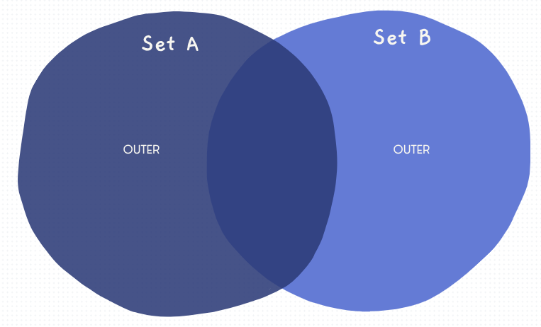
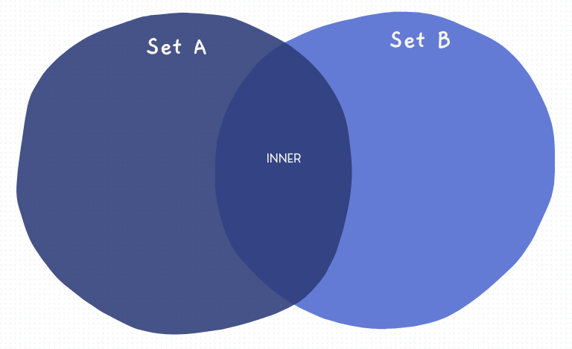
Inner vs. Outer

Slide 7
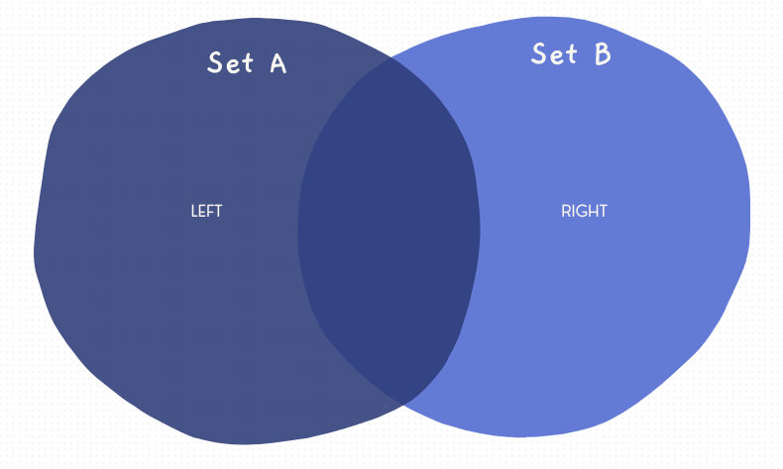
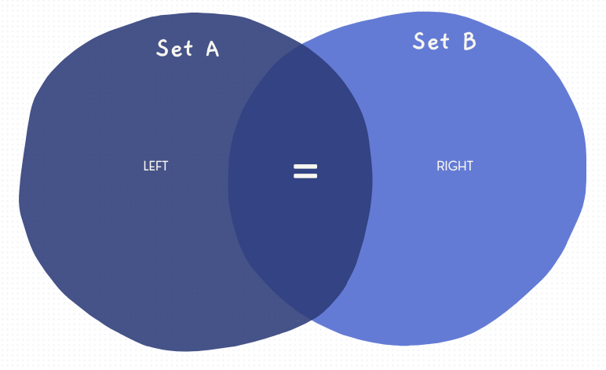
Left vs. Right

Slide 8
Examples
Notes:
http://localhost:8888/notebooks/Desktop/practice_file.ipynb

Slide 9
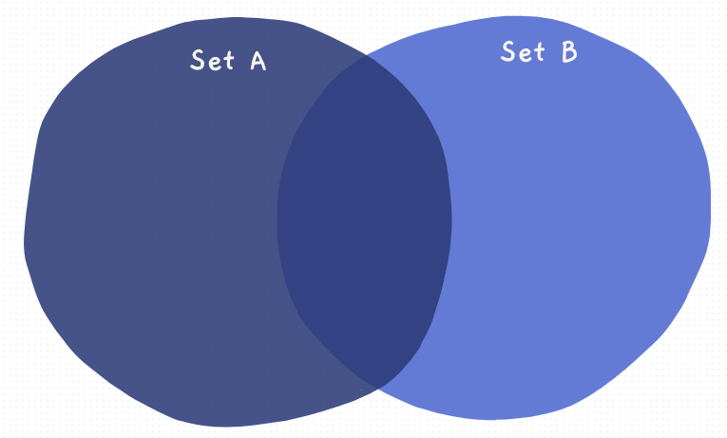
SELECT *
from assessments a
full outer join courses c
on a.code_presentation = c.code_presentation
Full

Slide 10
SELECT *
from assessments a
inner join courses c
on a.code_presentation = c.code_presentation
Inner

Slide 11
SELECT *
from assessments a
left outer join courses c
on a.code_presentation = c.code_presentation
Left

Slide 12
SELECT *
from assessments a
right outer join courses c
on a.code_presentation = c.code_presentation
Right

Slide 13
Tables store data …
Views store questions
Notes:
Use cases
Data management (like Narendra @ WGU)
ETL processes
More current data (pulls when you run the code)
Store the logic that is used

Slide 14
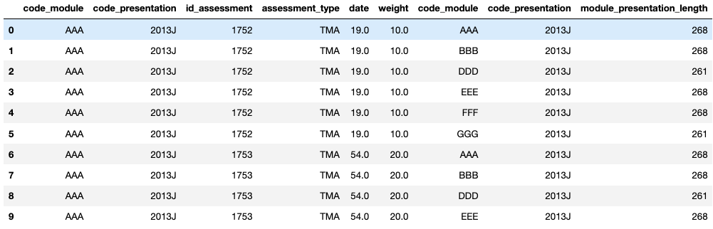
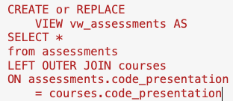
Table vs. View

Slide 15
Coming Next
Notes:
Using an alias
Conditions in queries - including joins where NOT

Slide 16
tl;dl
Notes:
Reviewing the four big ideas :
SQL is a structured (has rules) language (set of words) for building queries (asking questions)
Joins are a way to use relationships to ask better questions
The relationship and location of the tables matter
Tables store data, views store questions

